Slide 1
Customer Personality Analysis

Slide 2
About Dataset
Problem Statement
Customer Personality Analysis is a detailed analysis of a company’s ideal customers. It helps a business to better understand its customers and makes it easier for them to modify products according to the specific needs, behaviors and concerns of different types of customers.
Customer personality analysis helps a business to modify its product based on its target customers from different types of customer segments. For example, instead of spending money to market a new product to every customer in the company’s database, a company can analyze which customer segment is most likely to buy the product and then market the product only on that particular segment.

Slide 3
Attributes
People
ID: Customer's unique identifier
Year_Birth: Customer's birth year
Education: Customer's education level
Marital_Status: Customer's marital status
I ncome: Customer's yearly household income
Kidhome: Number of children in customer's household
Teenhome: Number of teenagers in customer's household
Dt_Customer: Date of customer's enrollment with the company
Recency: Number of days since customer's last purchase
Complain: 1 if the customer complained in the last 2 years, 0 otherwise

Slide 4
Products
MntWines: Amount spent on wine in last 2 years
MntFruits: Amount spent on fruits in last 2 years
MntMeatProducts: Amount spent on meat in last 2 years
MntFishProducts: Amount spent on fish in last 2 years
MntSweetProducts: Amount spent on sweets in last 2 years
MntGoldProds: Amount spent on gold in last 2 years

Slide 5
Promotion
NumDealsPurchases: Number of purchases made with a discount
AcceptedCmp1: 1 if customer accepted the offer in the 1st campaign, 0 otherwise
AcceptedCmp2: 1 if customer accepted the offer in the 2nd campaign, 0 otherwise
AcceptedCmp3: 1 if customer accepted the offer in the 3rd campaign, 0 otherwise
AcceptedCmp4: 1 if customer accepted the offer in the 4th campaign, 0 otherwise
AcceptedCmp5: 1 if customer accepted the offer in the 5th campaign, 0 otherwise
Response: 1 if customer accepted the offer in the last campaign, 0 otherwise

Slide 6
Places
NumWebPurchases: Number of purchases made through the company’s website
NumCatalogPurchases: Number of purchases made using a catalogue
NumStorePurchases: Number of purchases made directly in stores
NumWebVisitsMonth: Number of visits to company’s website in the last month

Slide 7
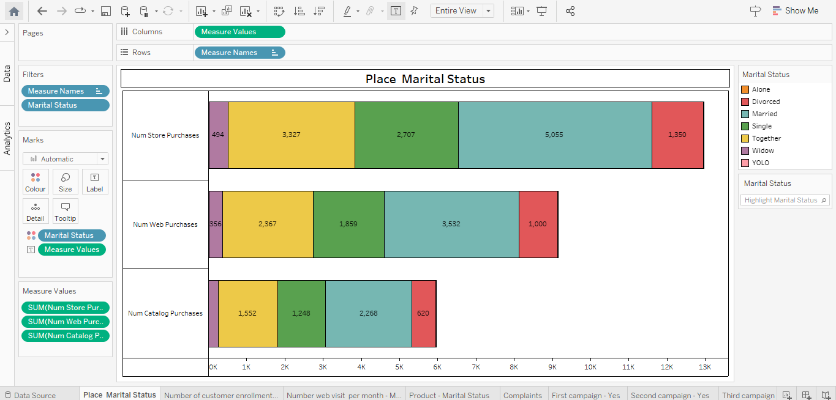

Slide 8
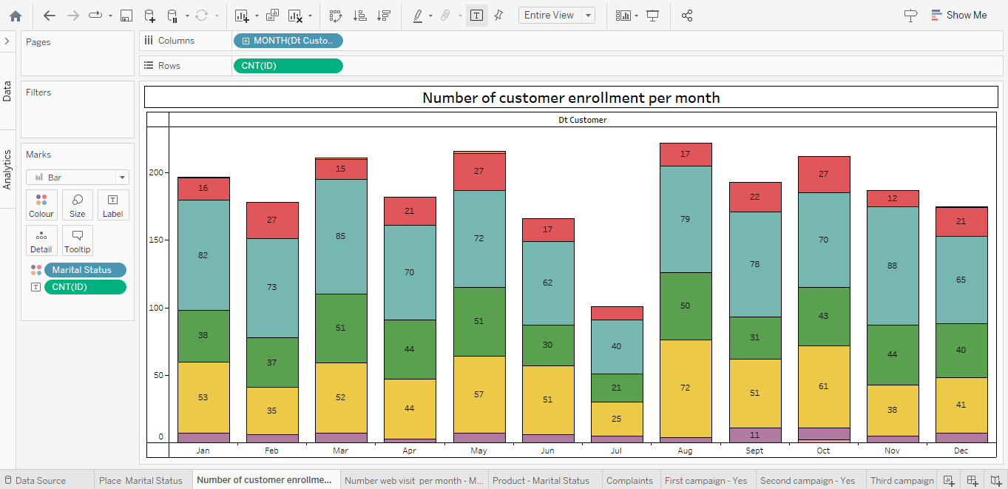

Slide 9
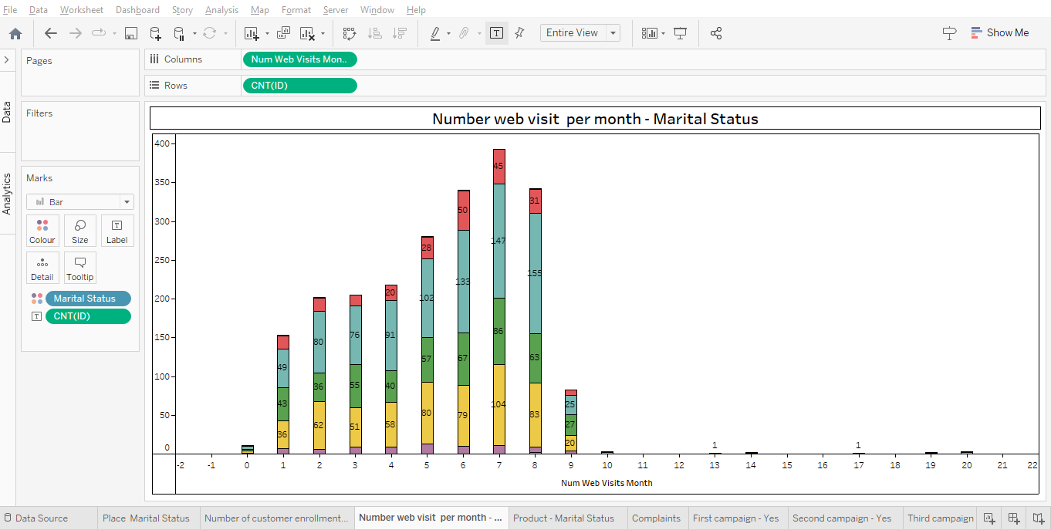

Slide 10
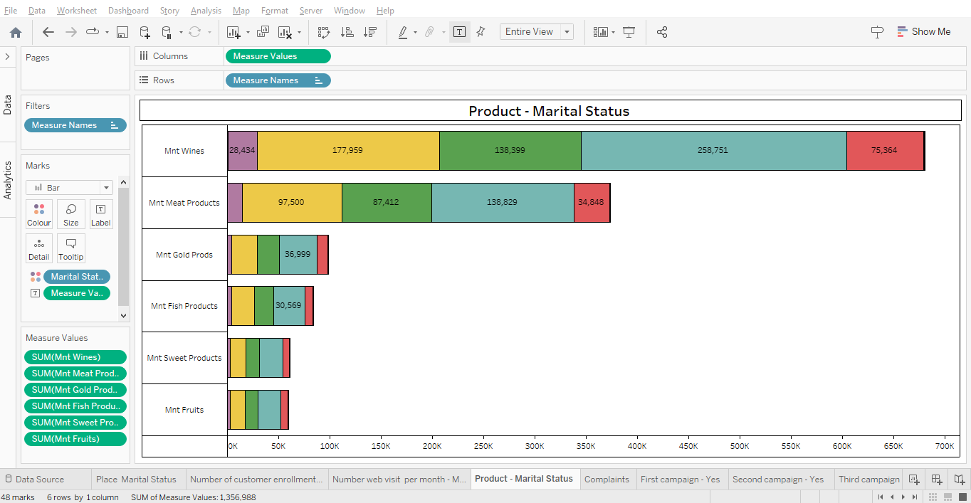

Slide 11
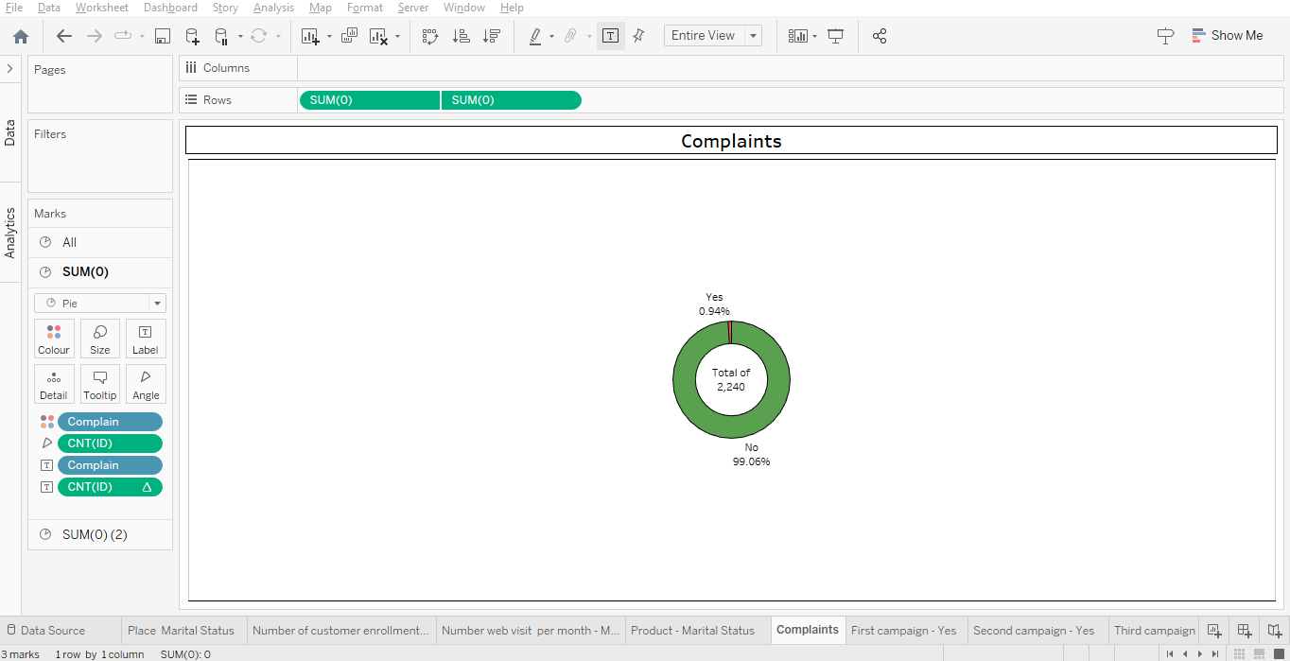

Slide 12
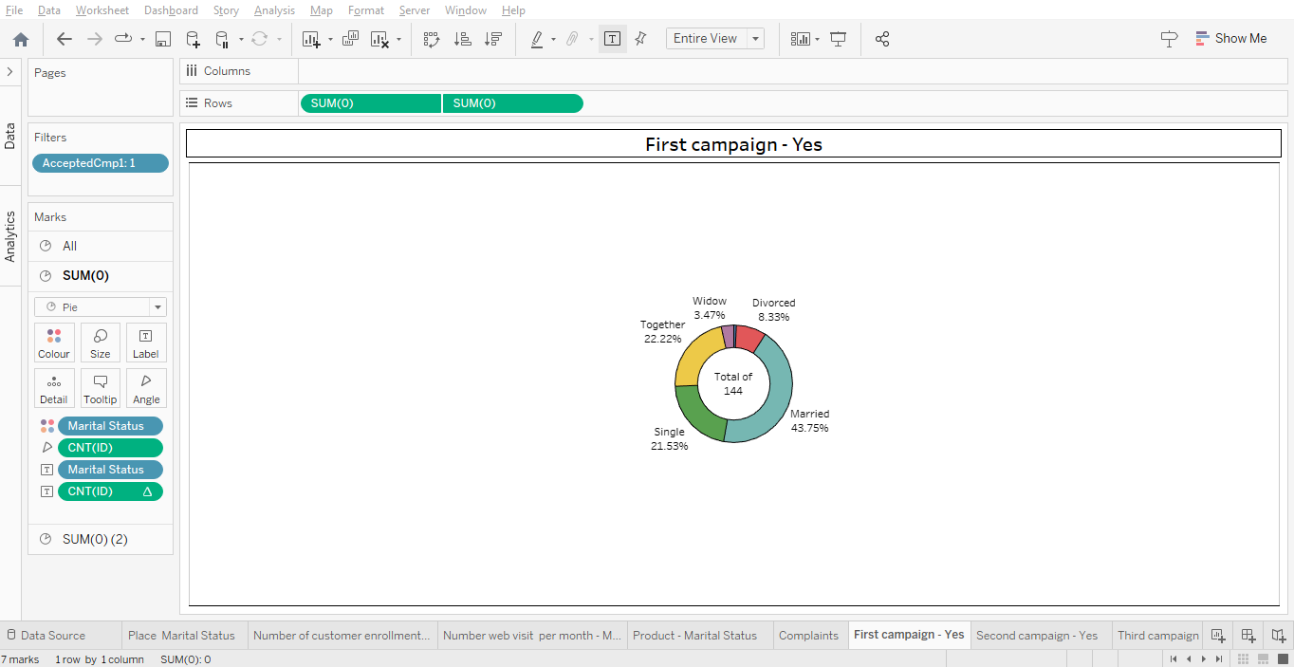

Slide 13
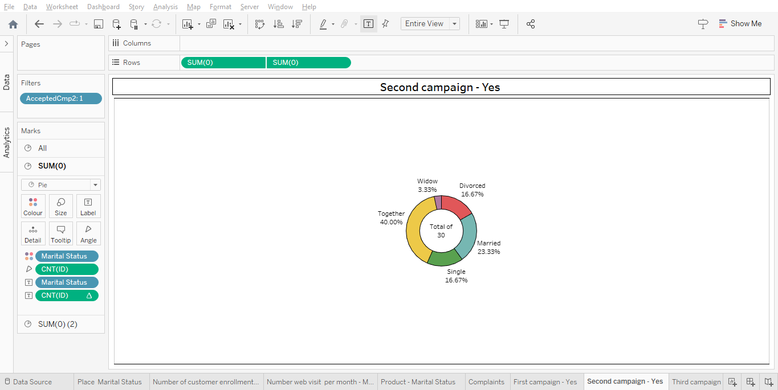

Slide 14
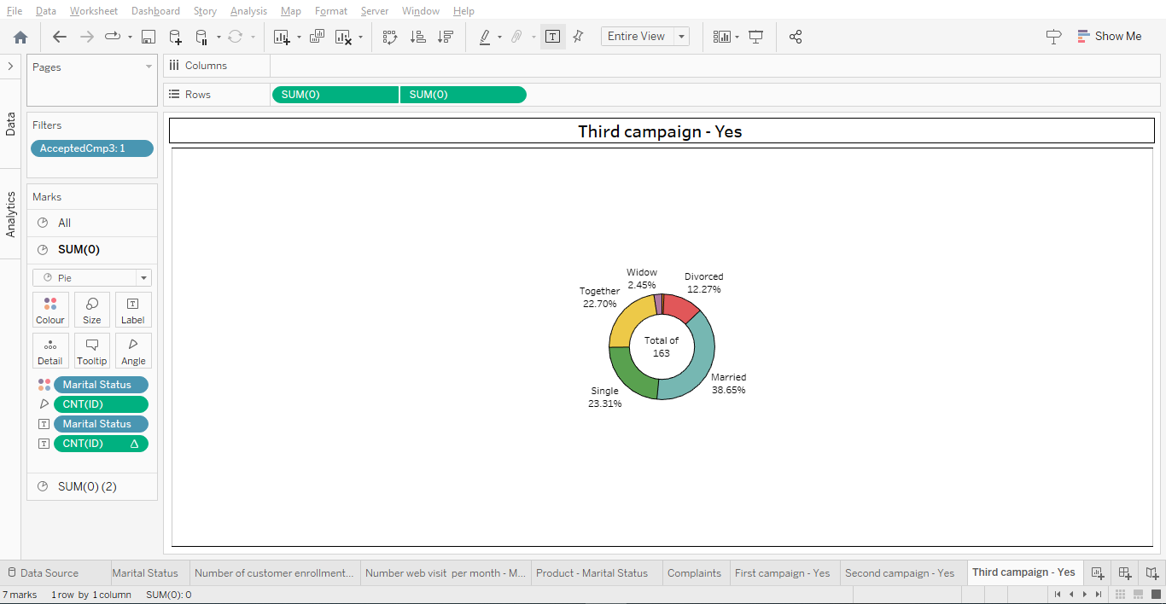

Slide 15
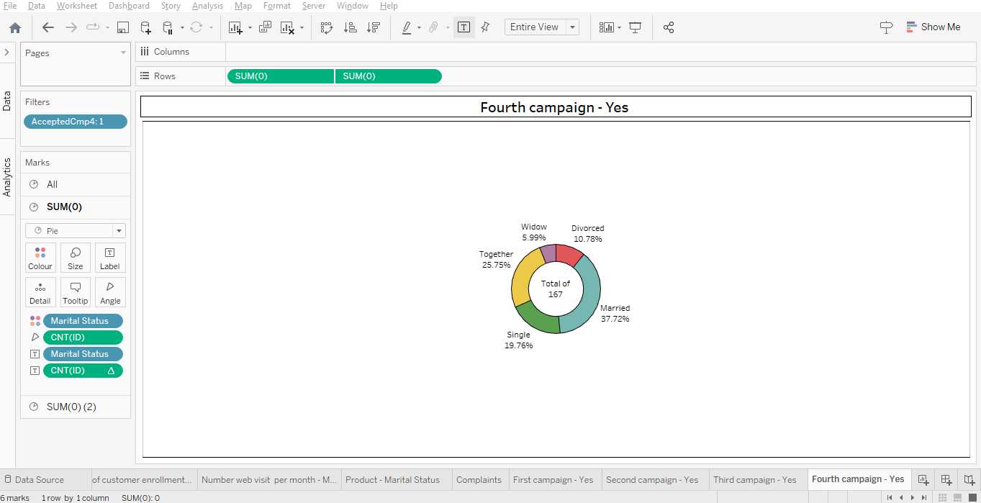

Slide 16


Slide 17
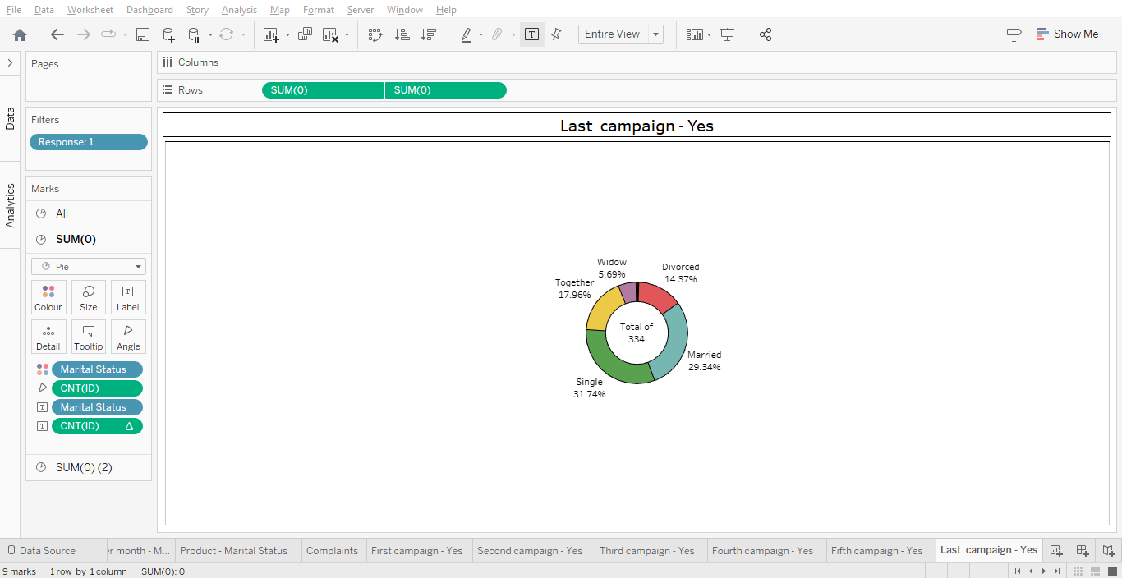

Slide 18
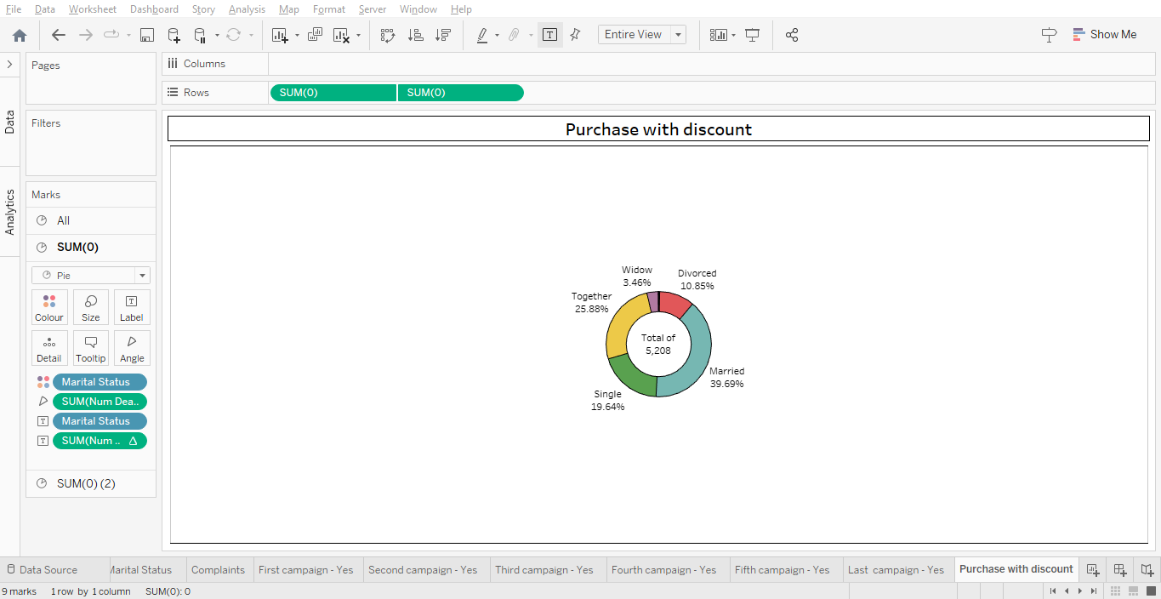

Slide 19
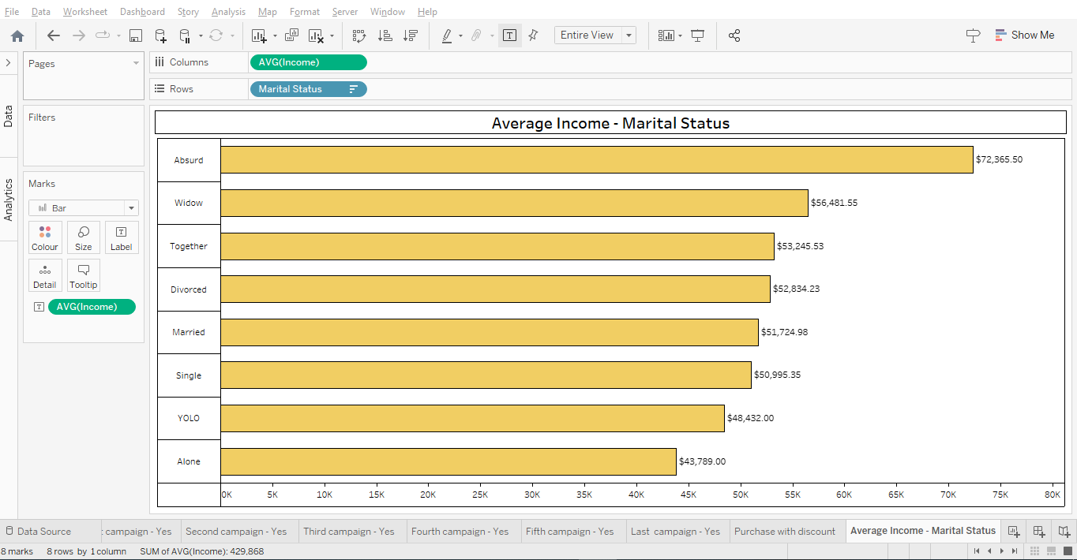

Slide 20
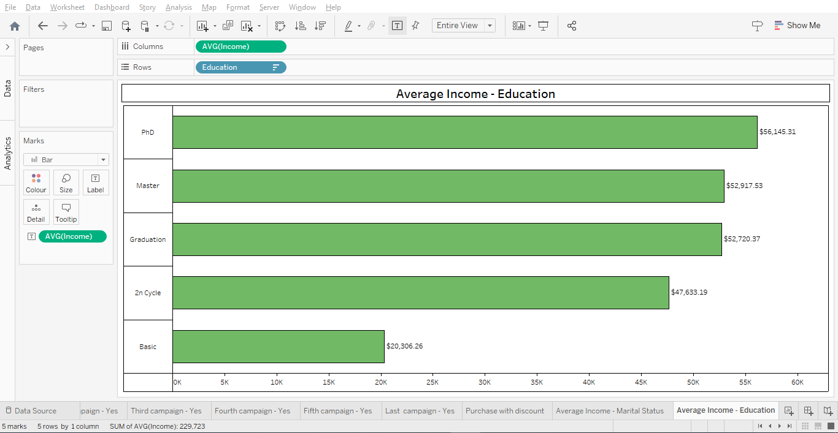

Slide 21
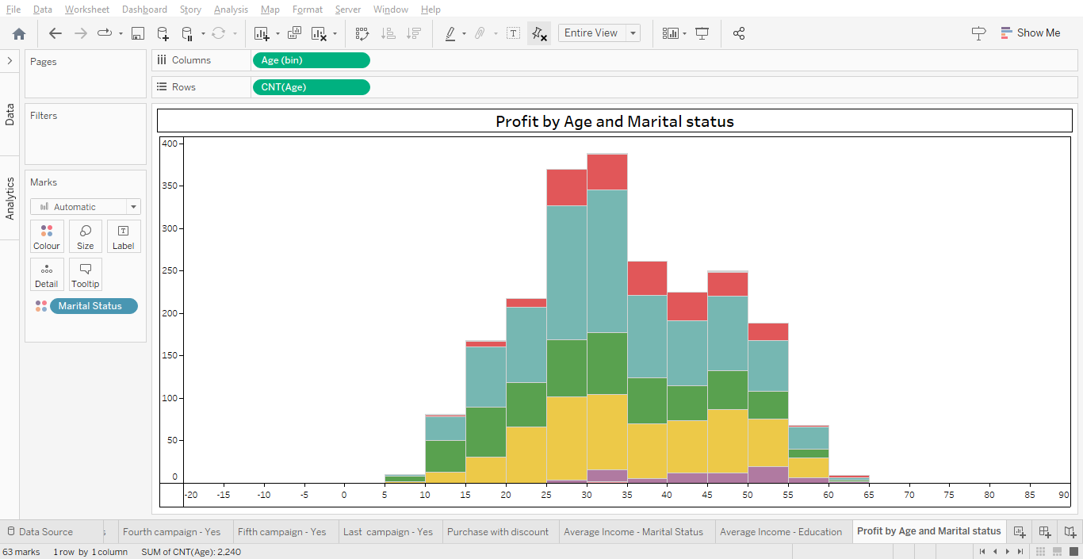

Slide 22
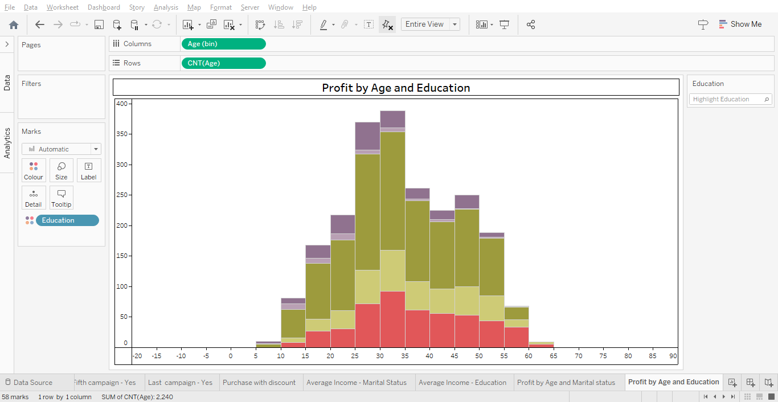

Slide 23
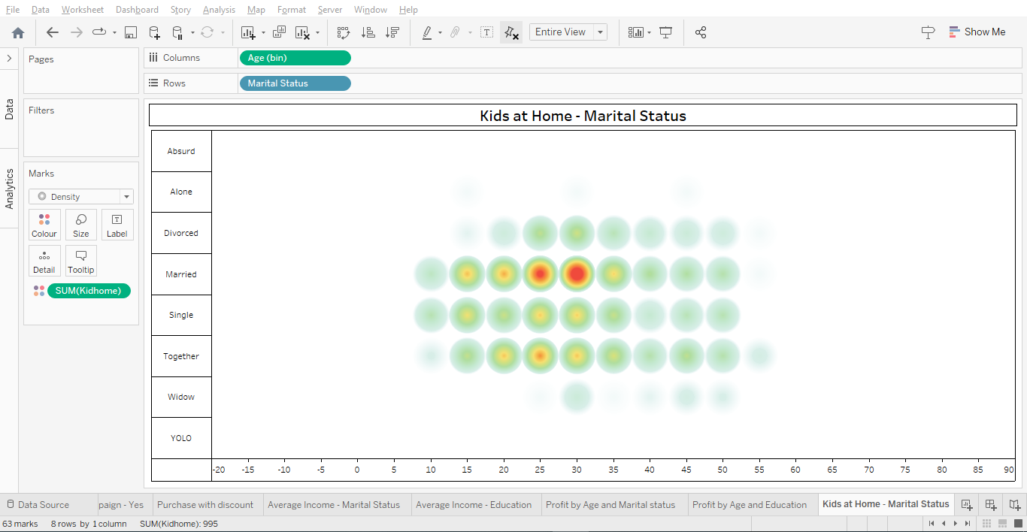

Slide 24
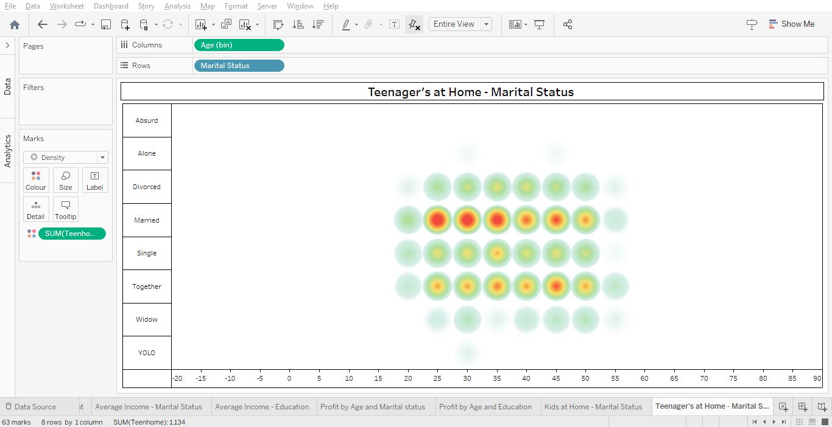

Slide 25
FINAL IMAGE OF DASHBOARD

Slide 26
